Slide 1
Support Vector Machine
- second part
091601
  by Huafu Chen
SLST, UESTC, China

Slide 2
6.3 optimal hyperplane for nonseparable patterns;
- What about regularisation?
Important that we don’t allow noise to spoil our generalisation:
we want a soft margin of separation
Introduce slack (松弛）variables e_{i} >= 0 such that:
d_{i}(w^{T}x_{i} + b) >= 1 – e_{i} for i= 1, .. N (6.22)
Rather than: d_{i}(w^{T}x_{i} + b) >= 1
The support vectors are those particular data points
that satisfy eq.(6.22) precisely even if e_{i} >0.
Notes:
The support vectors are those particular data points that satisfy eq.(6.22) precisely even if ei>0.

Slide 3
0 < e_{i} <= 1
e_{i} > 1
e_{i} = 0
Support vectors are those point d_{i}(w^{T}x_{i} + b) = 1 – e_{i} 0<e_{i}

Slide 4
The slack variables measure our deviation from the ideal pattern separability
and also allow us some freedoms in specifying the hyperplane
Therefore formulate new problem to minimise:
(6.23) F(w, e ) = 1/2 w^{T}w + C Σe_{i}
subject to:
d_{i}(w^{T}x_{i} + b) >= 1- e_{i} for i= 1, .. N
And :
e_{i} >= 0
Where C acts as a (inverse) regularisation parameter
which can be determined experimentally or analytically.
Notes:
Page 324/325: 最优超平面的统计性质
SVM 的最优超平面 使 分离最大，也使 VC dimension 减小 (6.19)，因此，从结构风险最小 它也是合理的
(6.23): Minimizing the first term is related to minimization the VC dimension of SVM (结构项），
the second term is an upper bound on the number of test errors. (训练误差）
选的支持向量 越多，W的模就 越大，VC 维数， 方差/confidence interval 大，但误差减小
Thus this formulation is therefore in perfect accord with the principle of structural risk minimization.
And the C controls the tradeoff between complexity of the machine and the number of noseparable points. Thus a regularization parameters

Slide 5
The solution proceeds in the same way as before (Lagrangian, formulate dual and maximise) to obtain optimal a_{i} for:
Q(a)= Σ a_{i} – ½ Σ Σ a_{i} a_{j} d_{i} d_{j} Κ(x_{i}, x_{j})
subject to the constraints
Σ a_{i} d_{i} =0 ; 0<= a_{i} <= C
Thus, the non-separable problem differs from the separable one only in that the second constraint is more stringent (严厉）. Again the optimal solution is:
w₀ = Σ a_{0,i} d_{i} φ(x_{i})
However, this time the Karush-Kuhn-Tucker conditions imply （induce ) that: e_{i} = 0 if a_{i} < C
So we may take data points (xi,di) ( for which e_{i} = 0 ) to determine b₀ by w₀^{T}x_{i} + b₀= 1
Notes:
参照前面： di(wx+b)>1 的点, ai=0; di(wx+b)=1, ai<C (原来没有限制）， di(wx+b)=1-ei( ei>0)的， ai=C
这里第1点，选出 那些点， 第2/3点， 因为这里 是让 L 针对 ai 最大化，因此，ai应越小越好，。。。
ai<=C
意味着 对 那些 支撑点 看得 比一般点重！?
ai<C 是否意味着那些点 在L 中的作用不大 （ai→0) （在正常情况，下的那些背后的点 ，ai=0 )， 因此 也不需要什么 slack 量
在这里 ei 不需要管，在优化程序中自动确定，需要的只是 C.

Slide 6
6.7-6.8 SVMs for non-linear regression
SVMs can also be used for non-linear regression. However, unlike MLPs and RBFs the formulation does not follow directly from the classification
Starting point: we have input data
X = {(x₁,d₁), …., (x_{N},d_{N})}
Where x_{i} is in D dimensions and d_{i} is a scalar. We want to find a robust function f(x) that has at most ε deviation from the targets d, while at the same time being as flat (in the regularisation sense of a smooth boundary) as possible.

Slide 7
Thus setting:
f(x) = w^{T}φ(x) + b
The problem becomes, minimize:
½ w^{T}w ------- flatness
[think y=ax+b, a smaller a, means a smaller gradient]
Subject to:
d_{i} - (w^{T}φ(x_{i}) + b) <= ε
−−−−ε deviation
w^{T}φ(x_{i}) + b - d_{i} <= ε

Slide 8
+ε
L(f,y)
−ε
ε
This formalisation is called ε -insensitive regression as it is equivalent to minimising the empirical risk(实际风险） (amount you might be wrong) using an ε -insensitive loss function:
L(f, d, x) = | f(x) – d | - ε for | f(x) – d | >= ε
= 0 else (6.45)

Slide 9
Comparing ε -insensitive loss function
to least squares loss function (used for MLP/RBFN)
More robust (robust to small changes in data/ model)
Less sensitive to outliers
Non-continuous derivative
Cost function is:
C Σ_{i} L(f, d_{i}, x_{i})
Where C can be viewed as a regularisation parameter

Slide 10
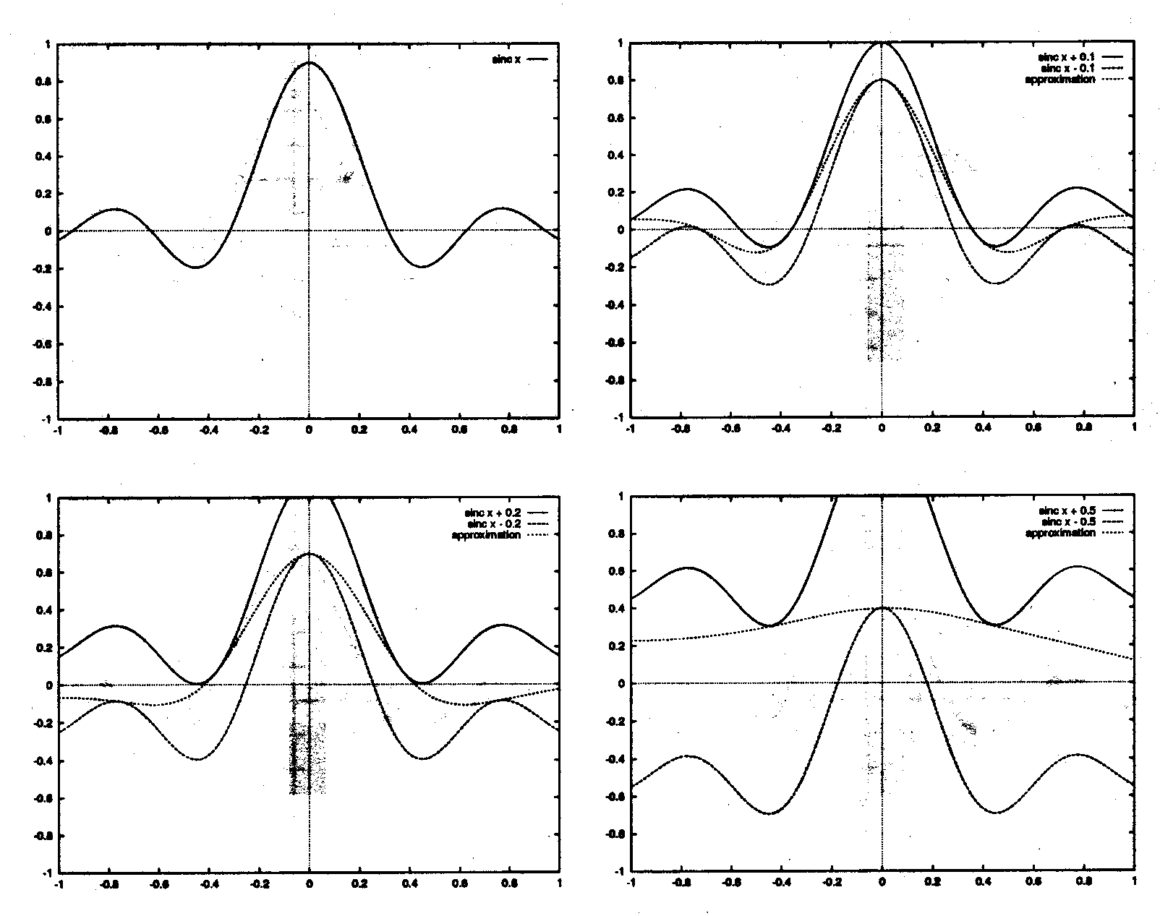
Ο + ε
Original (O)
ε = 0.1
Ο − ε
ε = 0.2
ε = 0.5
Regression for different ε: function selected is the flattest
Notes:
Jian Tian fMRI response 函数 容许变化
最优函数， 容许 函数是通过 “e”误差的那些点，容许函数

Slide 11
We now introduce 2 slack variables, e_{i} and e_{i}* as in the case of nonlinearly separable data and write:
d_{i} - （w^{T}φ(x_{i}) + b） <= ε + e_{i}
w^{T}φ(x_{i}) + b） - d_{i} <= ε + e_{i}*
Where: e_{i} , e_{i}* >= 0
Thus: C Σ L(f, d_{i}, x_{i}) = C Σ (e_{i} + e_{i}*)
( according to (6.45) L (|d_{i} - （w^{T}φ(x_{i}) + b| )= e_{i} / e_{i}*
And the problem becomes to minimise:
F(w, e ) = 1/2 w^{T}w + C Σ (e_{i} + e_{i}*)
subject to:
d_{i} - w^{T}φ(x_{i}) + b <= ε + e_{i}
w^{T}φ(x_{i}) + b - d_{i} <= ε + e_{i}*
And : e_{i} , e_{i}* >= 0
在ε − insensitive的基础上，再考虑slack variables for support vectors)
Notes:
在ε − insensitive的基础上，
再考虑slack variables for support vectors)
在e管外，具体的点 还有ei, ei* “差” 别

Slide 12
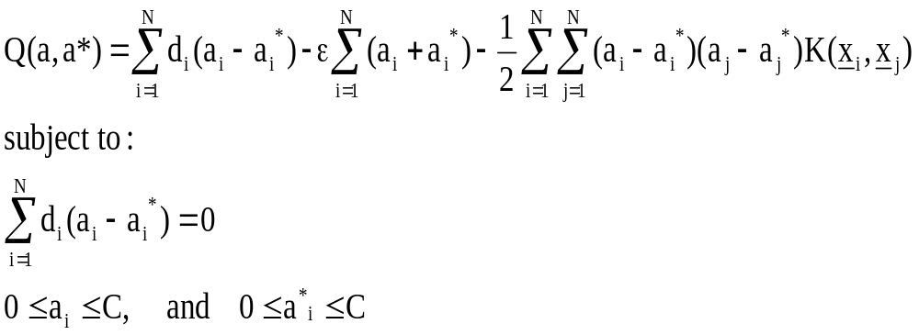
We now form the Lagrangian, and find the dual. Note that this time, there will be 2 sets of Lagrangian multipliers as there are 2 constraints. The dual to be maximised is（6.59)/page 342:
Where ε and C are free parameters that control the approximating function:
f(x) = w^{T}φ(x)
= Σ_{i} (a_{i} – a_{i}*) K (x, x_{i})
Notes:
QP 的二次函数

Slide 13
From the KKT conditions we now have ( at the saddle point):
a_{i} (ε +e_{i} - d_{i} + w^{T}x_{i} + b) = 0
a_{i}* (ε +e_{i}* + d_{i} - w^{T}x_{i} - b) = 0
This means that the Lagrange multipliers a_{i} ，a_{i}* will only be non-zero for points where:| f(x_{i}) – d_{i} | >= ε .
( Βecause |f(x_{i}) – d_{i} | -( ε+ e_{i} (e_{i}* ))=0, a_{i}，a_{i}* may be non-zero)
That is, only for points outside the ε tube.
+ε
Thus these points are the support vectors and we have a sparse expansion of w in terms of x
−ε
SVs: Points outside the ε tube, and satisfy
(ε +e_{i}* + d_{i} - w^{T}x_{i} - b) = 0
Notes:
只管 tube外的点，tube内的点视而不见 （e-insensitive)，在tube 外 加上 ei/ei’ 后的点作为support vectors

Slide 14
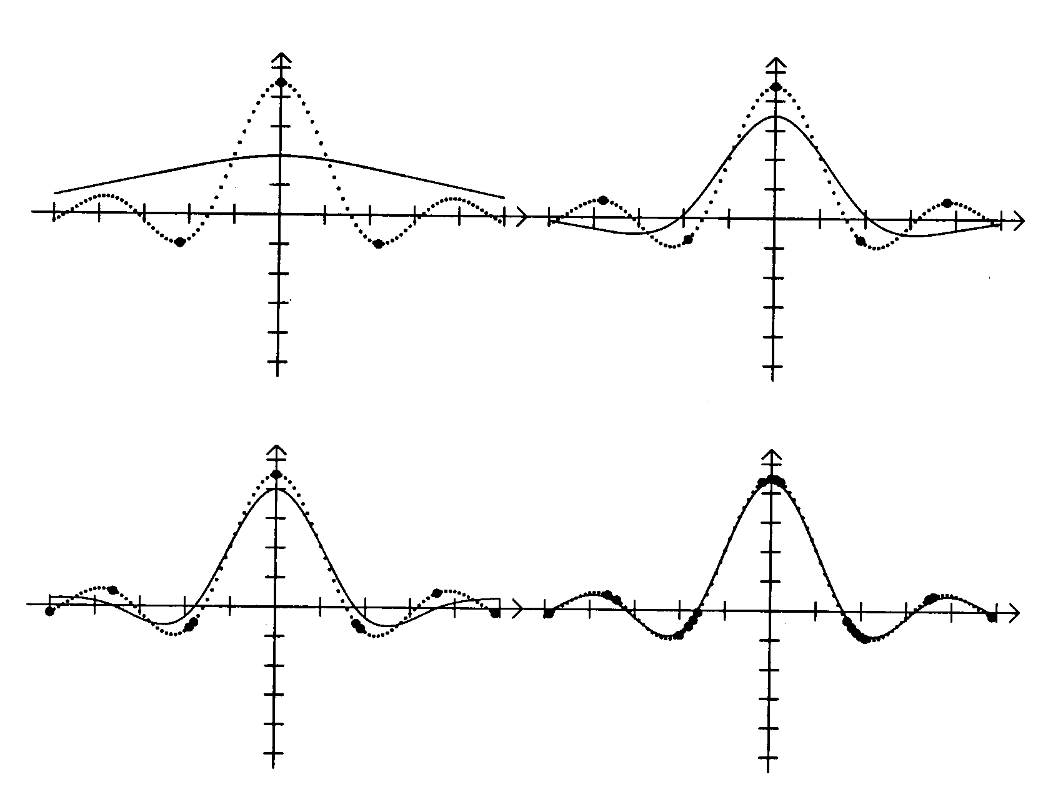
ε = 0.5
ε = 0.2
SVs
Data points
ε = 0.1
ε = 0.02
ε Controls the amount of SVs selected (non-zero a’s)
: outside the ε tube.

Slide 15
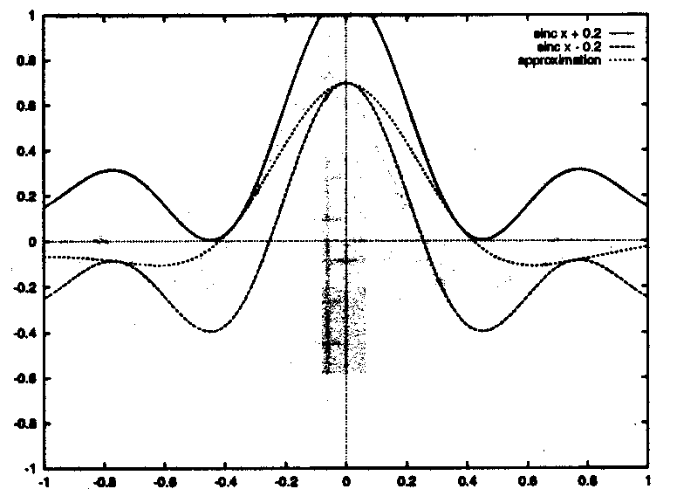
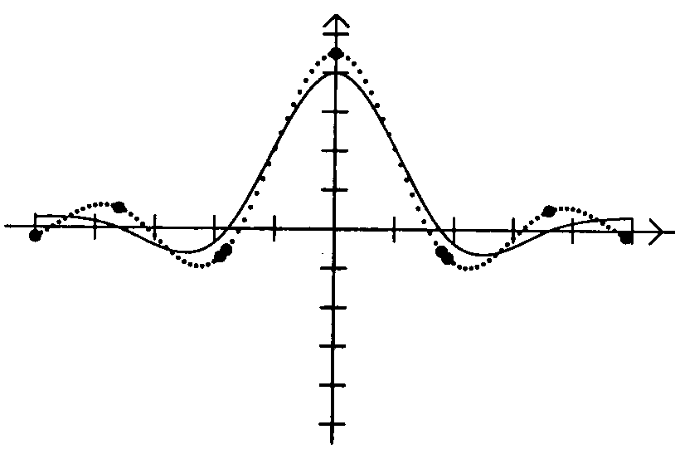
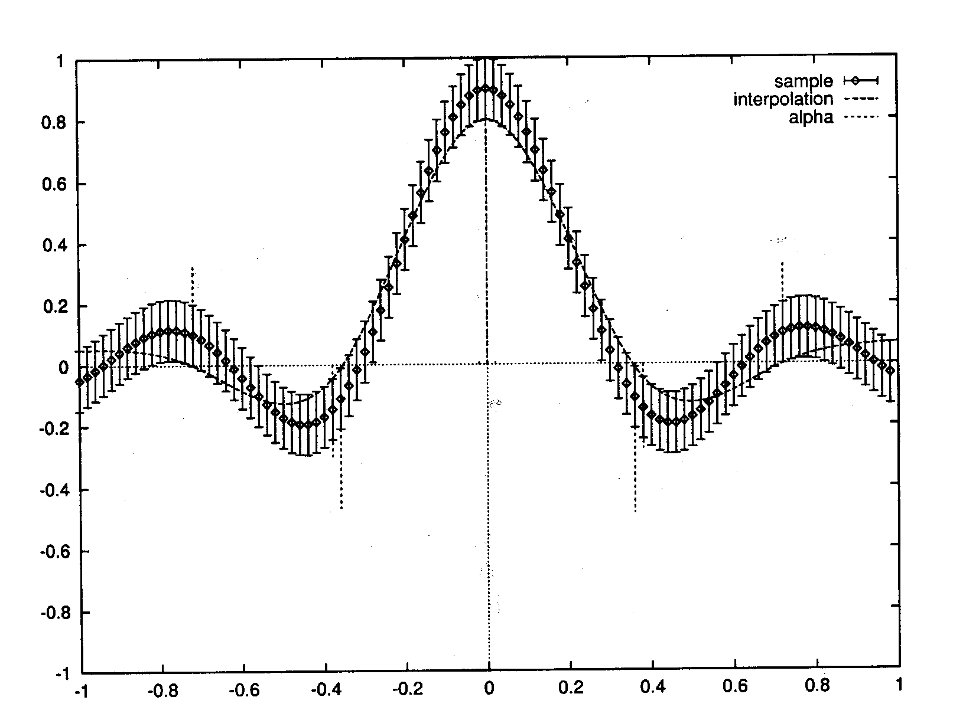
Only non-zero a’s can contribute:
the Lagrange multipliers act like forces on the regression. However, they can only be applied at points outside or touching the ε tube
Points where forces act
f(x)=w^{T}φ(x) = Σ_{i}(a_{i} – a_{i}*) K (x, x_{i})

Slide 16
One note of warning:
Regression is much harder than classification for 2 reasons
1. Regression is intrinsically more difficult than classification
2. ε and C must be tuned simultaneously

Slide 17
Research issues:
Incorporation of prior knowledge e.g.
  train a machine,
  add in virtual support vectors which incorporate known invariances, of SVs found in 1.
  Re-train
Speeding up training time?
Various techniques, mainly to deal with reducing the size of the data set.
Chunking: use subsets of the data at a time and only keep SVs. Also, more sophisticated versions which use linear combinations of the training points as inputs

Slide 18
Optimisation packages/techniques?
  Off the shelf ones are not brilliant (including the MATLAB one). Sequential Minimal Opitmisation (SMO) widely used. For details of that and others see:
  A. J. Smola and B. Schölkopf. A Tutorial on Support Vector Regression. NeuroCOLT Technical Report NC-TR-98-030, Royal Holloway College, University of London, UK, 1998.
Selection of ε and C

Slide 19
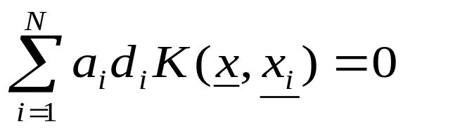
With Haykin software directory as the working path of Matlab /page 336 6.6
Three steps:
Training samples (x_{i},d_{j} )
1. Choose the kernel function K
2. Determine a_{i} by solving the following equation
Q(a) = Σ a_{i} – ½ Σ Σ a_{i} a_{j} d_{i} d_{j} Κ(x_{i}, x_{j})
and the constraints:
Σ a_{i} d_{i} =0 ; 0<= a_{i} <= C
3. Resulted hyper-plane

Slide 20
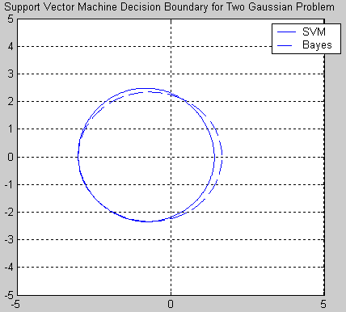
With Haykin software directory as the working path of Matlab /page 336 6.6
Bayes (optimal)
81.15%
Table 6.3/ page 338
500 points training
32000 points test
five times: average
81.40%
Almost the optimal
Notes:
% 1. make data set with 200 rows and 5columns
P = mk_data(200);
% 2. run the SVM routine,return weights, support vectors and bias
[pesos,vect,b] = svm_rbf(P, 8, 1000, .01, .1);
% 3. make a test set with 200 rows and 5columns
T = mk_data(200);
% 4. test data ,return percents of correct classifications and uncorrect classifications
[c u] = svm_test(T, pesos, vect, b, 8);
% 5. plots the decision boundary for the two class Gaussian problem
svm_dec_bnd(pesos, vect, b, 8)

